Slide 1

Hiring (Create EMPLOYMENT)

Slide 2


Slide 3
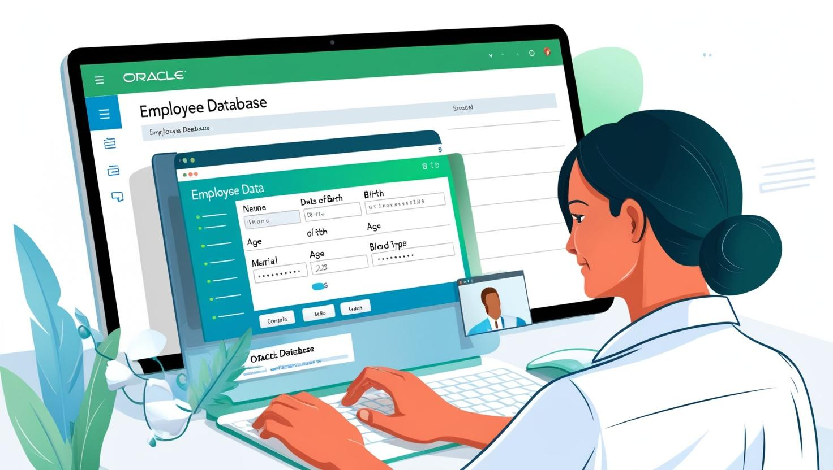
Personal Details

Slide 4
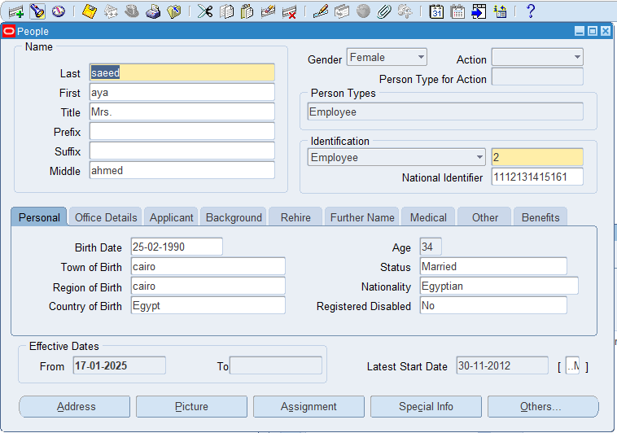

Slide 5
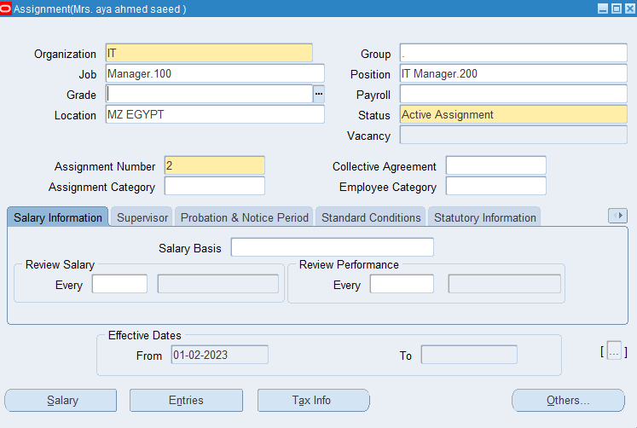

The assignment

Slide 6
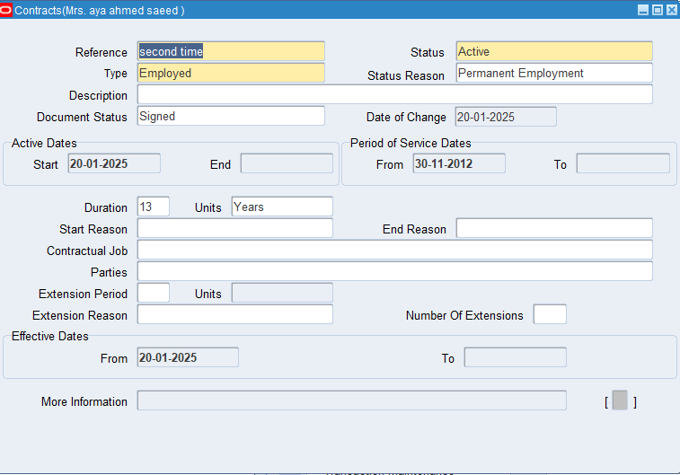

Contract

Slide 7
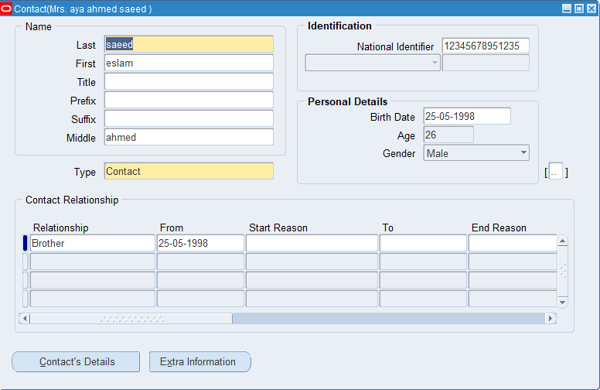

Contact Here we take all the information of the contact who could be catch up with in case we could not reach to the employee

Slide 8
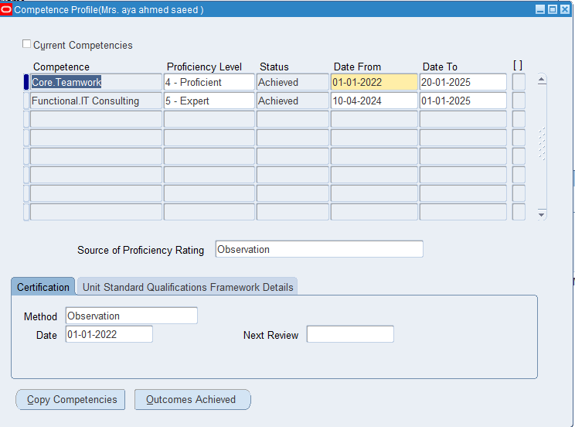
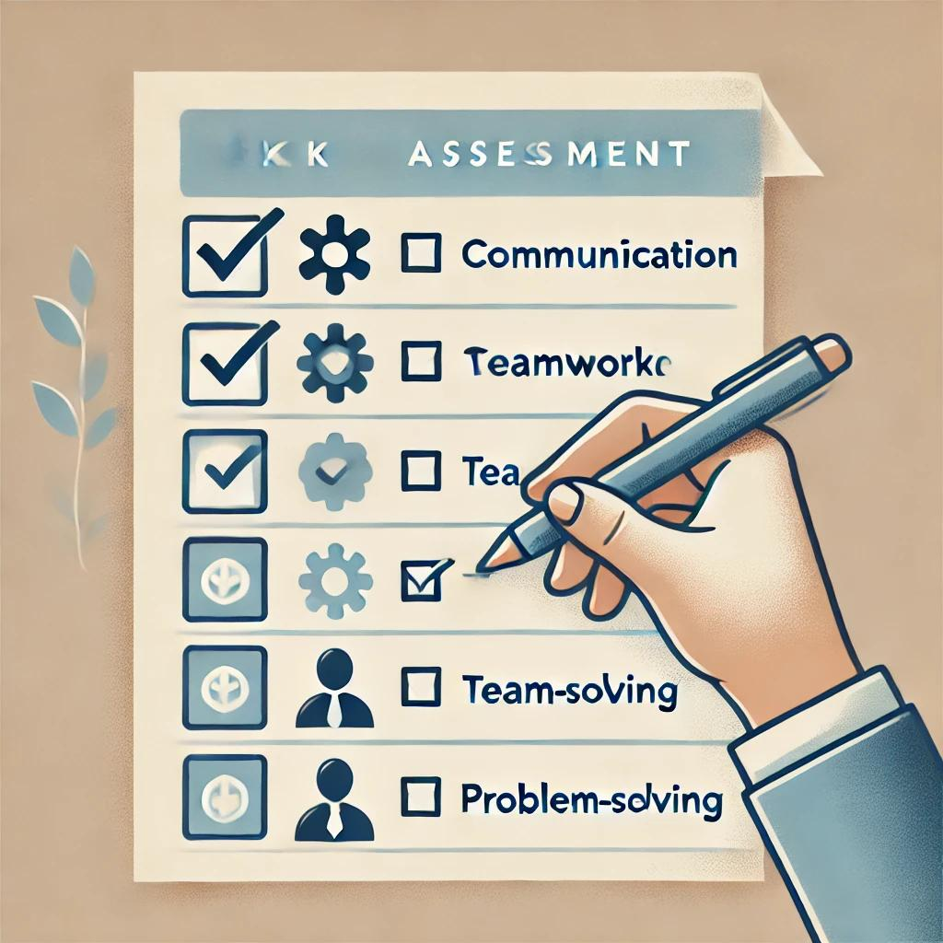
competences

Slide 9

1-Absence type
2- Reason
3- starting and ending date
4- Authorization
5- Replacement
Types of Absences in Oracle
Annual Leave
Sick Leave
Training Leave
Other Absence Types

Slide 10
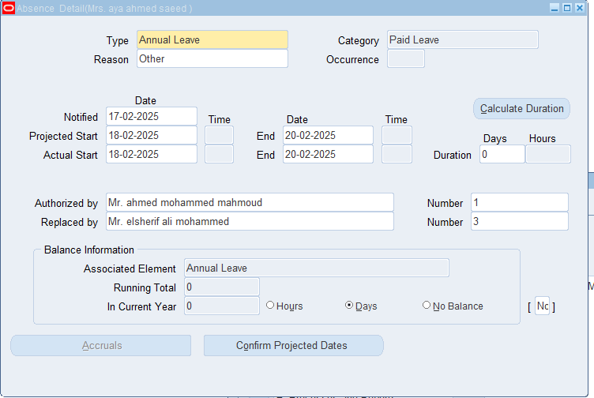
The absence

Slide 11

Payroll

Slide 12
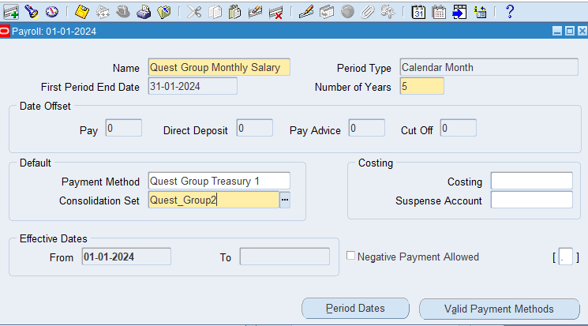


Slide 13
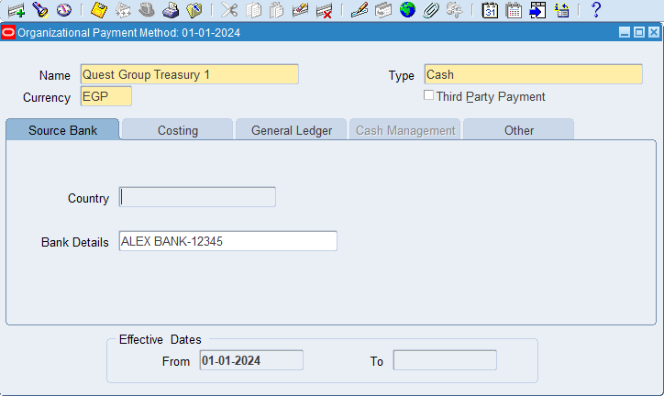

Payment Methods
And here we determine the method we will pay the employees by

Slide 14
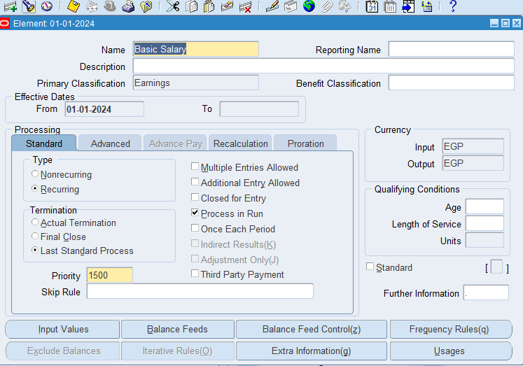

Defining Compensation Elements
The elements of employee's payments and
Which are ( Basic salary – Housing – etc.…)

Slide 15
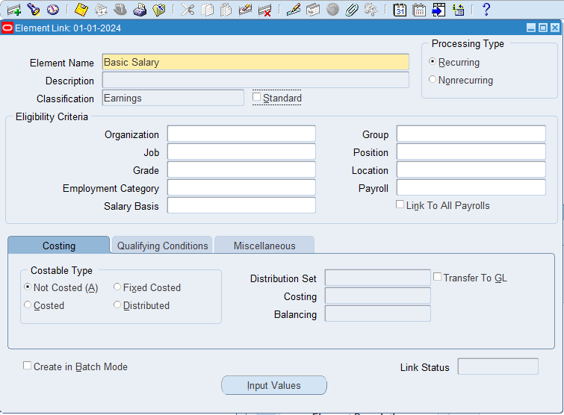

Then we link these elements
to the input of employees to appear in their salary

Slide 16


Slide 17
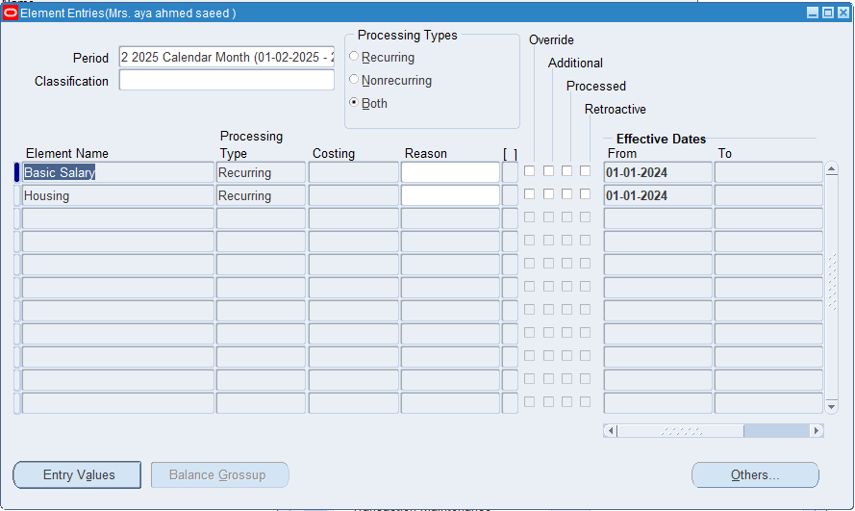
Adding payment elements to the employee

Slide 18
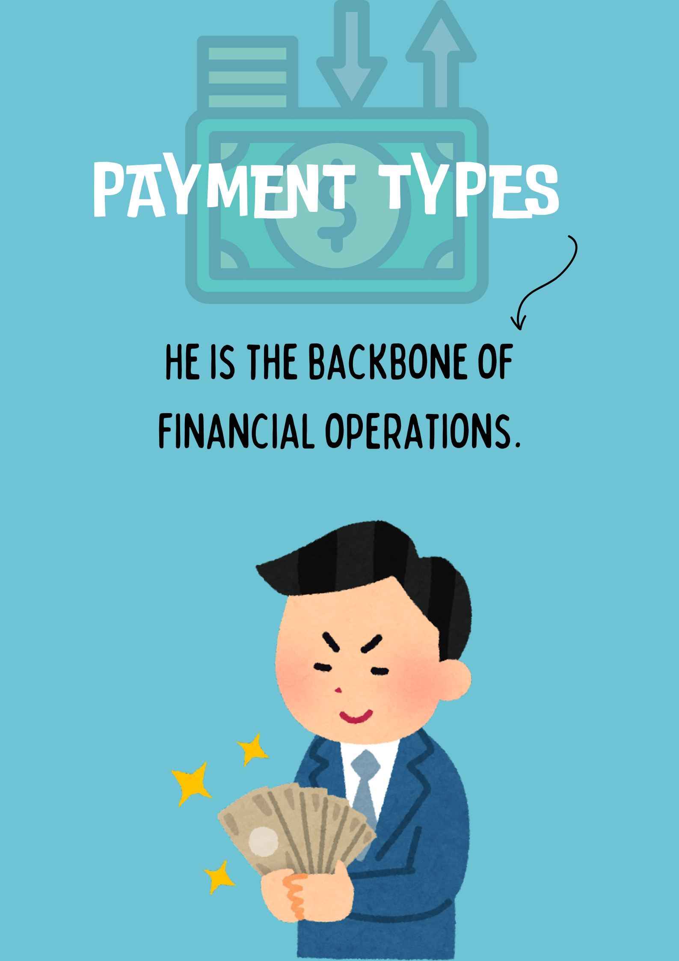

Slide 19
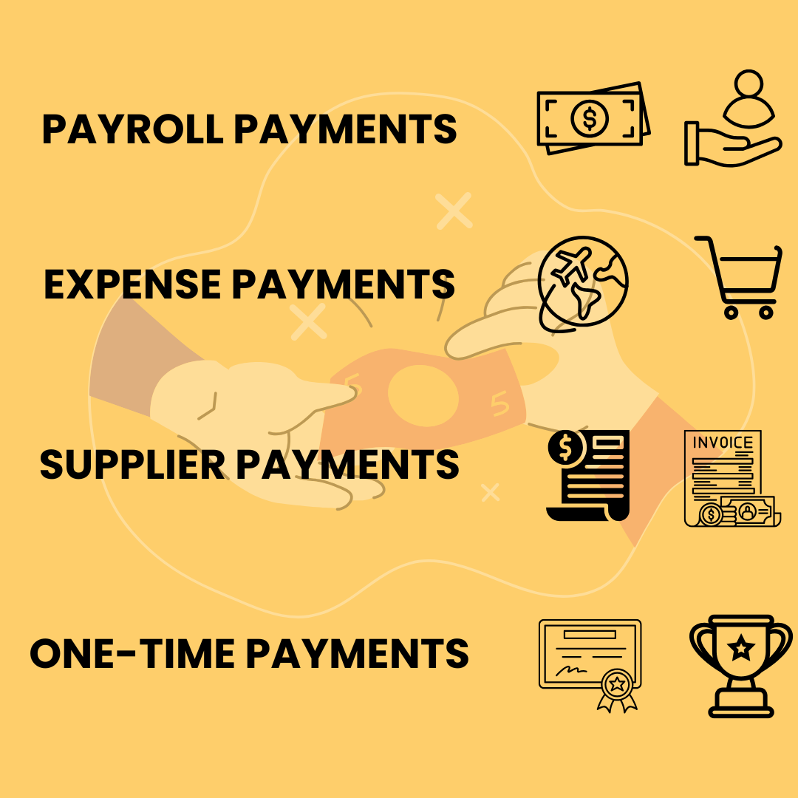

Slide 20
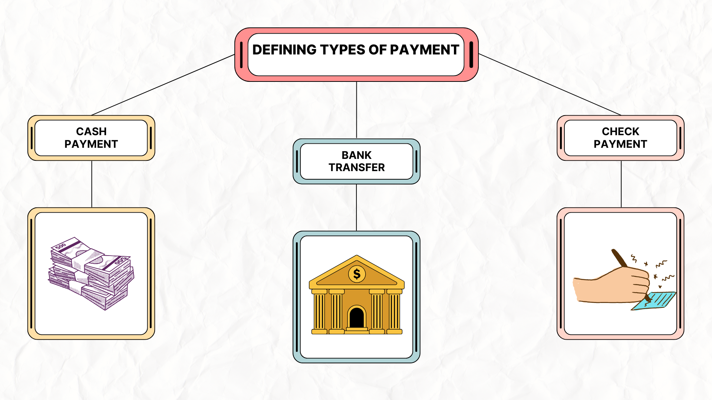


Slide 21


Slide 22

Live Example

Slide 23
The importance of formulas
Reduce manual input
minimize errors
Designing accounts based on the company's policy
Automatically applying taxes, insurance, and incentives according to regulations
save time

Slide 24




Thank You…
www.facebook.com/QuestGroup
www.linkedin.com/QuestGroup
www.QuestGroup.com

Slide 25

Questions

